Slide 1
Multivariate Analysis of Variance (MANOVA)
Prof. Andy Field

Slide 2
Aims
When and why do we Use MANOVA?
Issues for MANOVA analysis
Theory behind MANOVA:
  SSCP matrices
  Discriminant variates
  MANOVA test statistics

Slide 3

When and Why
To test for differences between groups
When we have several outcome variables (DVs)
Better than multiple ANOVA
  Controls familywise error rate (Type I error)
  Takes account of relationships between DVs

Slide 4

Issues in MANOVA
Selecting dependent variables
Test statistics (choice of four)
Power
  Power depends upon correlations between dependent variables
  Conflicting evidence about test power

Slide 5
Theory: An Example
Efficacy of psychotherapy on OCD
Three groups:
  cognitive behaviour therapy (CBT)
  behaviour therapy (BT)
  no treatment (NT)
Two outcome variables (DVs):
  obsession-related actions
  obsession-related thoughts

Slide 6
Theory of ANOVA (Revision)
SS_{T}
Total Variance in the Data
SS_{M}
SS_{R}
Improvement Due to the Model
Error in Model
F ∝ SS_{M}/SS_{R}

Slide 7
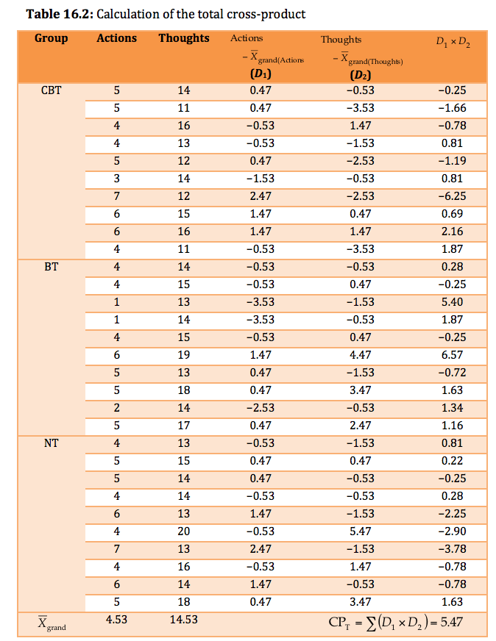
Total Cross-Products

Slide 8
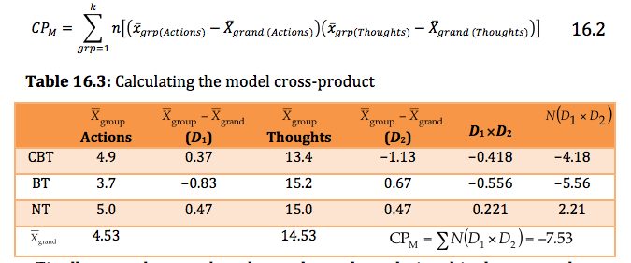
Model Cross-Products

Slide 9
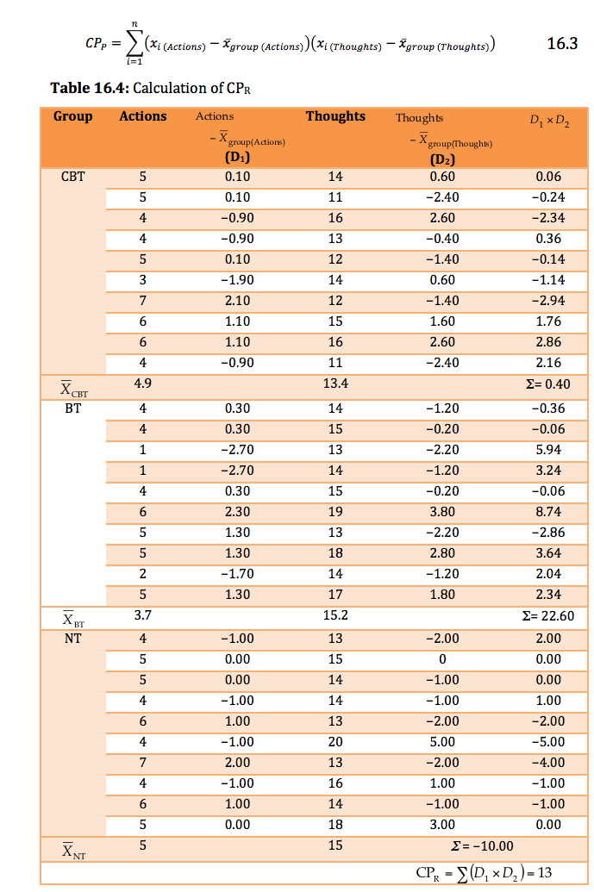
Residual Cross-Products

Slide 10
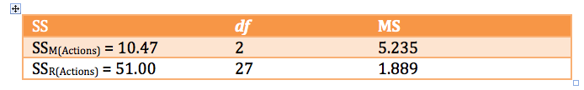
Sums of Squares

Slide 11
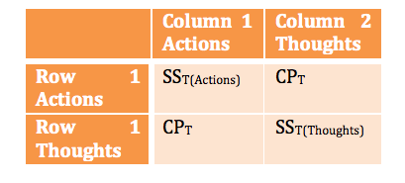
MANOVA Matrices: Total SSCP (T)

Slide 12
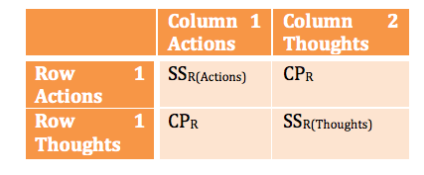
MANOVA Matrices: Residual SSCP (E)

Slide 13
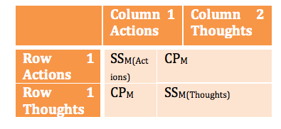
MANOVA Matrices: Model SSCP (M)

Slide 14
An Equivalent to F …

Slide 15
The Result …

Slide 16
Discriminant Variates

Slide 17
Eigenvalues (λ_{i})

Slide 18
Pillai–Bartlett Trace

Slide 19
Hotelling’s Trace

Slide 20
Wilks’s Lambda

Slide 21
Roy’s Largest Root

Slide 22
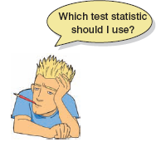
Which Test Statistic?
Issues to consider
  Power
  Robustness
  Equality of sample sizes
Pillai’s trace
  Robust when sample sizes are equal

Slide 23
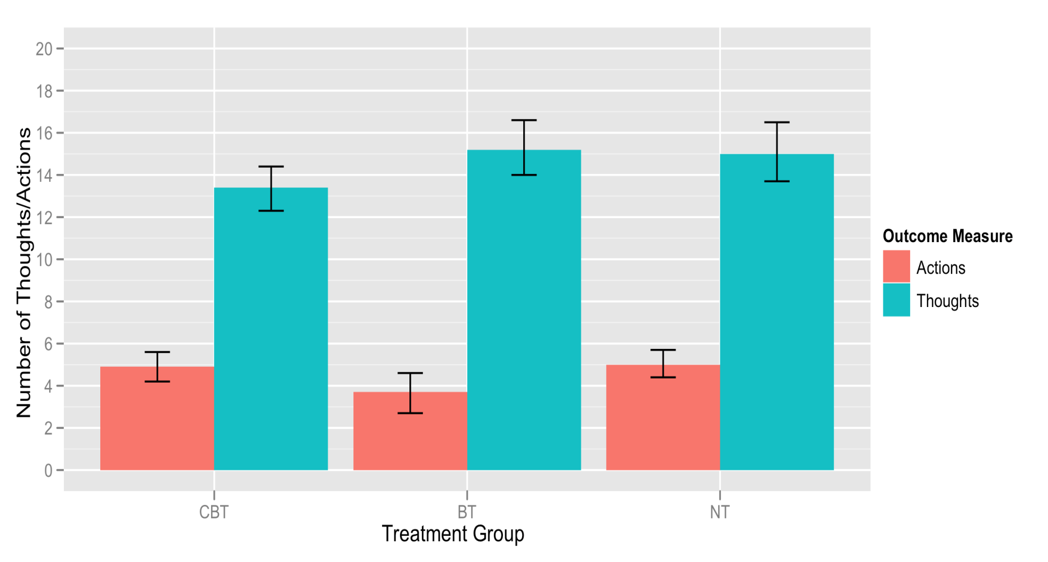
Exploring Data

Slide 24
Setting contrasts
For this example it makes sense to compare each of the treatment groups to the no-treatment control group. The no-treatment control group was coded as the last category, so we could set this contrast by executing:
  contrasts(ocdData$Group)<-contr.treatment(3, base = 3)

Slide 25
Setting contrasts
Alternatively, we could set the contrasts by executing:
  CBT_vs_NT<-c(1, 0, 0)
  BT_vs_NT <-c(0, 1, 0)
  contrasts(ocdData$Group)<-cbind(CBT_vs_NT, BT_vs_NT)

Slide 26
The MANOVA model
In the case of MANOVA there are several outcomes so the model becomes ‘outcomes ~ predictor(s)’.
To put multiple outcomes into the model, we have to bind the variables together into a single entity using the cbind() function:
  outcome<-cbind(ocdData$Actions, ocdData$Thoughts)
We use this new object as the outcome in our model, and specify any predictors as we have in previous chapters:
  ocdModel<-manova(outcome ~ Group, data = ocdData)

Slide 27
Obtaining the Output
To see the output of the model we use the summary command; by default, R produces Pillai’s trace (which is a sensible choice), but we can see the other test statistics by including the test = option. For example, to see all four test statistics we would need to execute:
  summary(ocdModel, intercept = TRUE)
  summary(ocdModel, intercept = TRUE, test = "Wilks")
  summary(ocdModel, intercept = TRUE, test = "Hotelling")
  summary(ocdModel, intercept = TRUE, test = "Roy")

Slide 28
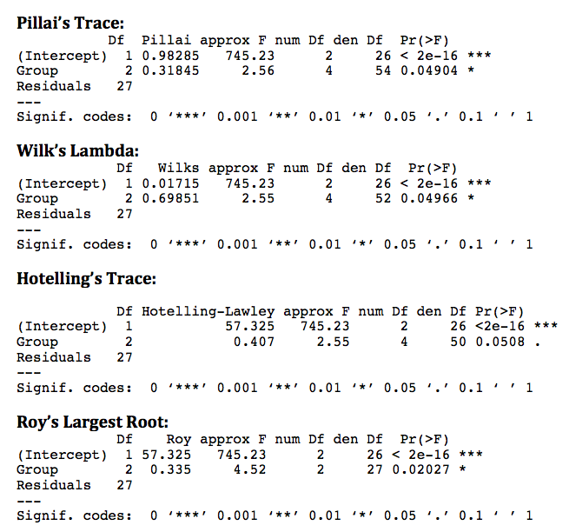

Slide 29
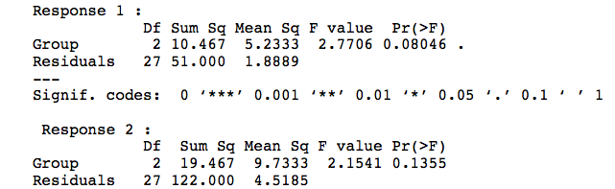
Follow-Up Analysis: Univariate Test Statistics
To follow up the analysis with univariate analyses of the individual outcome measures, execute:
  summary.aov(ocdModel)

Slide 30
Contrasts
The contrasts are not part of the MANOVA model and so to generate the output for them you have to create separate linear models for each outcome measure.
  actionModel<-lm(Actions ~ Group, data = ocdData)
  thoughtsModel<-lm(Thoughts ~ Group, data = ocdData)
  summary.lm(actionModel)
  summary.lm(thoughtsModel)

Slide 31
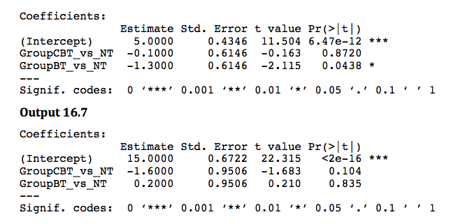
Contrasts

Slide 32
Robust MANOVA

Slide 33
Robust MANOVA
  ocdData$row<-rep(1:10, 3)
  ocdMelt<-melt(ocdData, id = c("Group", "row"), measured = c("Actions", "Thoughts"))
  names(ocdMelt)<-c("Group", "row", "Outcome_Measure", "Frequency")
  ocdRobust<-cast(ocdMelt, row ~ Group + Outcome_Measure, value = "Frequency")
  ocdRobust$row<-NULL
  ocdRobust

Slide 34
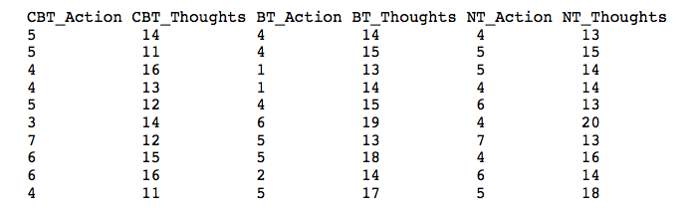
Robust MANOVA
  mulrank(3, 2, ocdRobust)
  cmanova(3, 2, ocdRobust)

Slide 35
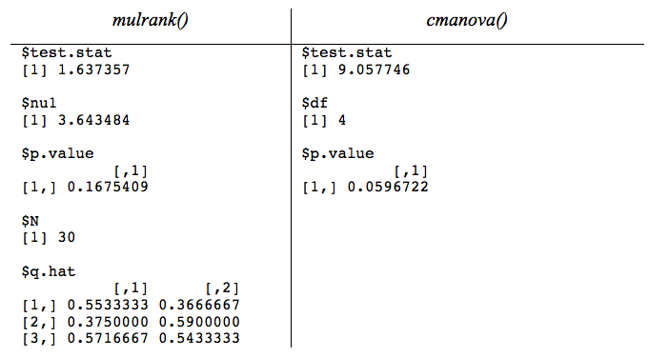

Slide 36
Following MANOVA with Discriminant Function Analysis
Discriminant analysis is quite straightforward in R: you use the lda() function from the MASS package. The basic format of this function is:
  newModel<-lda(Group ~ Predictor(s), data = dataFrame, prior = prior probabilities, na.action = "na.omit")
For the current data, we could, therefore, execute:
  ocdDFA<-lda(Group ~ Actions + Thoughts, data = ocdData)
  ocdDFA

Slide 37
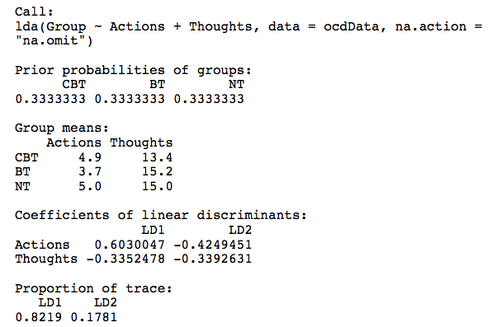
Discriminant Analysis Output

Slide 38
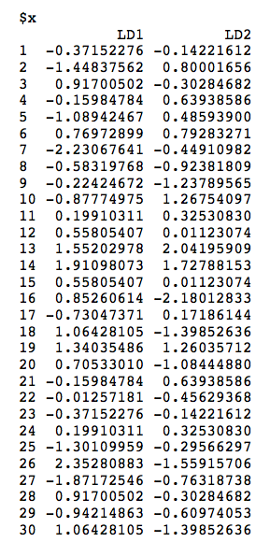
Discriminant Analysis Output

Slide 39
Discriminant Function Analysis

